Slide 1


Milwaukee Code Camp 2015
Principal Sponsor
Thank our Principal Sponsor by tweeting and following @SkylineTweets
http://www.SkylineTechnologies.com

Slide 2








Milwaukee Code Camp 2015
Gold Sponsors
Silver Sponsors

Slide 3


August 8th – 10th 2016
Kalahari Resort, Wisconsin Dells
http://www.ThatConference.com

Slide 4

JavaScript Task Runners for the ASP.NET Developer
October 24, 2015

Slide 5





About me and this talk
Scott Addie
.NET Solutions Architect
MCSD (Web Apps)
Visual Studio Code Insider
GitHub.com/scottaddie/mvc-task-runners
ScottAddie.com
@Scott_Addie
LinkedIn.com/in/scottaddie

Slide 6

What is a task runner?
Like MSBuild for JavaScript
Benefits:
Automates repetitive tasks
Enforces build consistency
Improves development workflow quality
Develop → Analyze → Test → Package → Deploy

Slide 7
Common responsibilities of task runners
Transpiling JS (TypeScript, Babel, etc.)
Transforming JS (bundling modules, ng-annotate, etc.)
Bundling files
Minifying files
Generating JS source maps
Preprocessing CSS (LESS, SASS, Stylus, etc.)
Transforming CSS (e.g., AutoPrefixer)
Busting the cache
Optimizing images
Copying files
Watching files for changes
Running unit tests
Analyzing code (e.g., linting)

Slide 8

If I have to remember, I’m going to forget

Slide 9
Why to use one with ASP.NET 5
3 Compelling Reasons

Slide 10

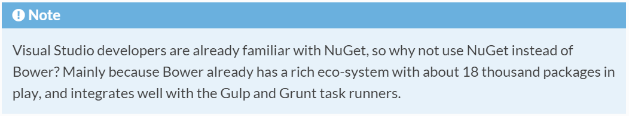
1. NuGet has been demoted
Open-source contributors neglect NuGet
Use Bower or NPM for client-side assets
Bower used for MVC 6’s unobtrusive JS
From the ASP.NET docs:
http://bit.ly/1lGF3s2

Slide 11
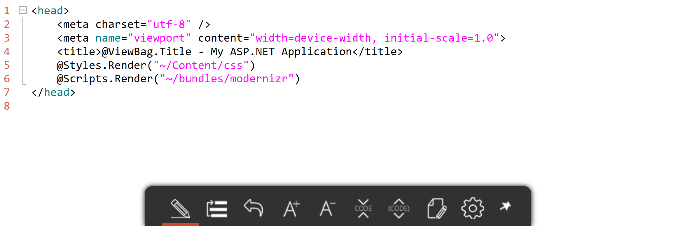
2. ASP.NET Bundling & Minification is obsolete
http://bit.ly/1KEc29U

Slide 12
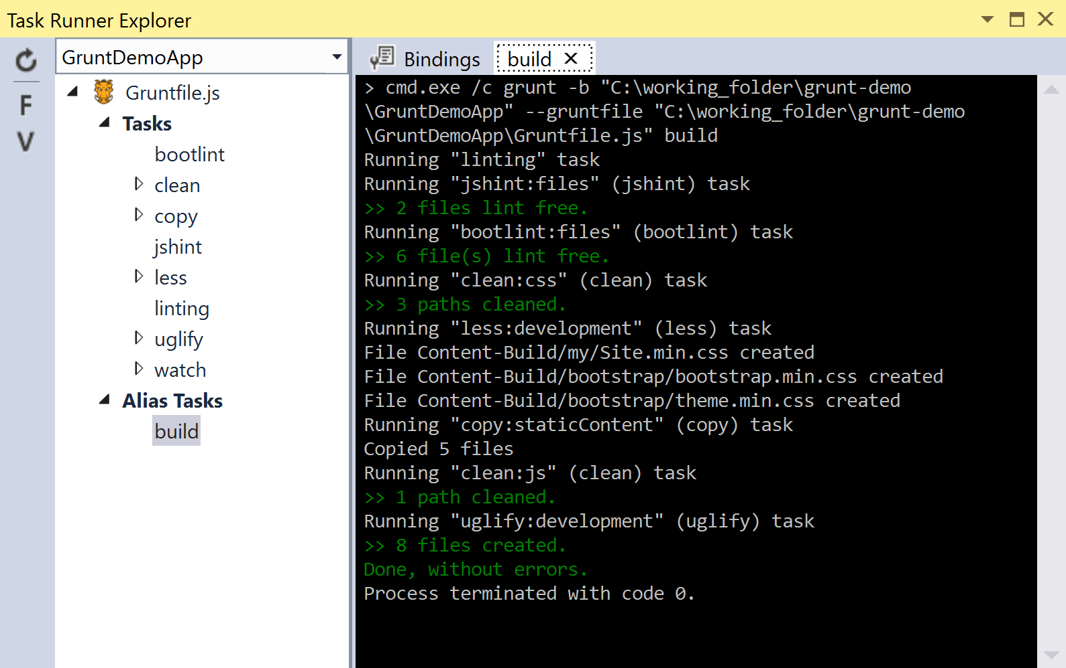
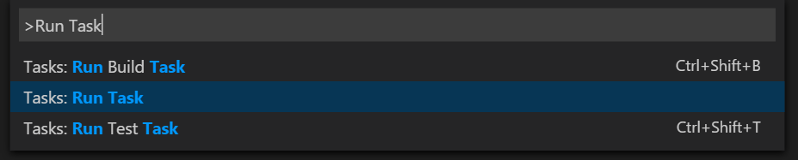
3. Command Palette & Task Runner Explorer make it easy
No need to use command line
Bind tasks to VS events

Slide 13

Which task runner should I use?
A task runner showdown

Slide 14


Files vs. Streams
Diagrams based on John Papa’s Pluralsight course

Slide 15
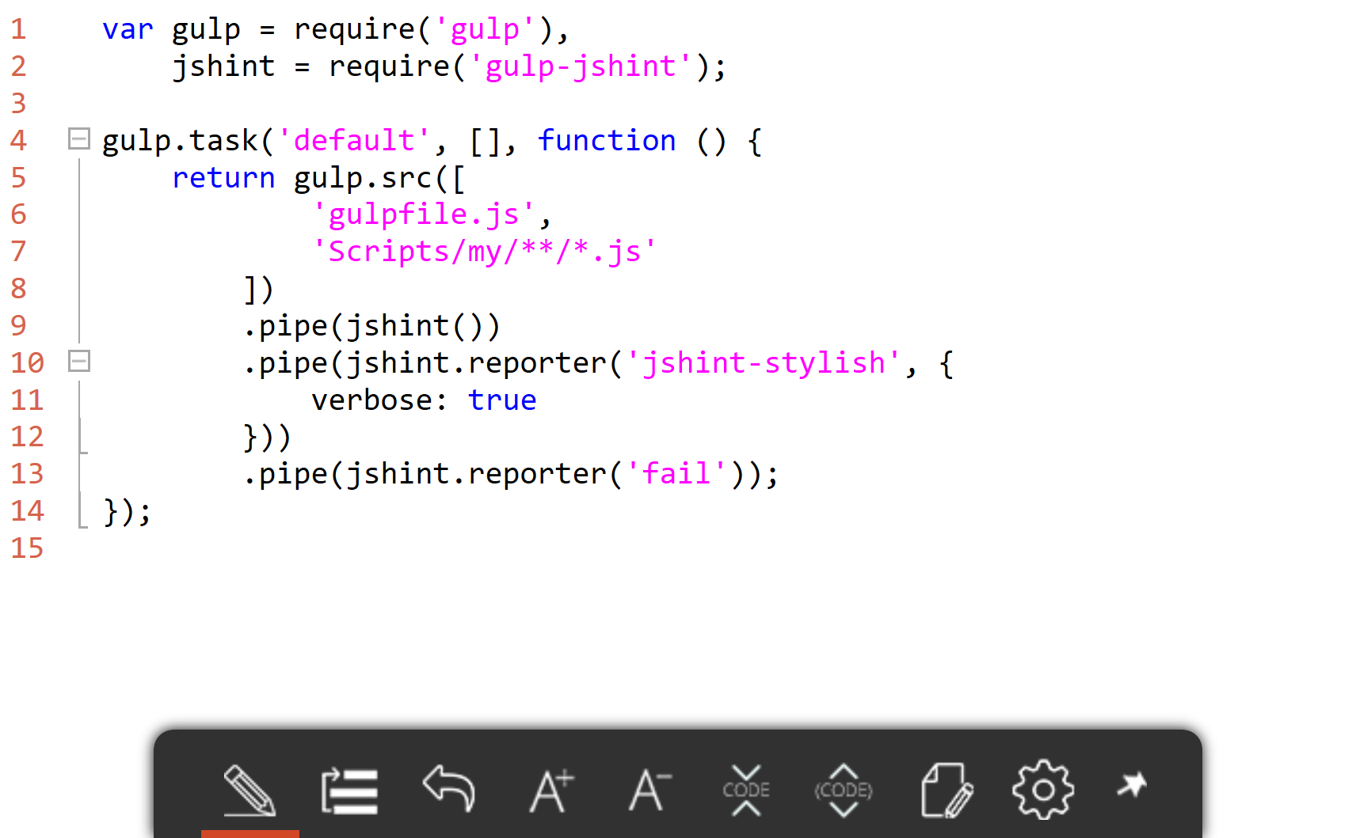
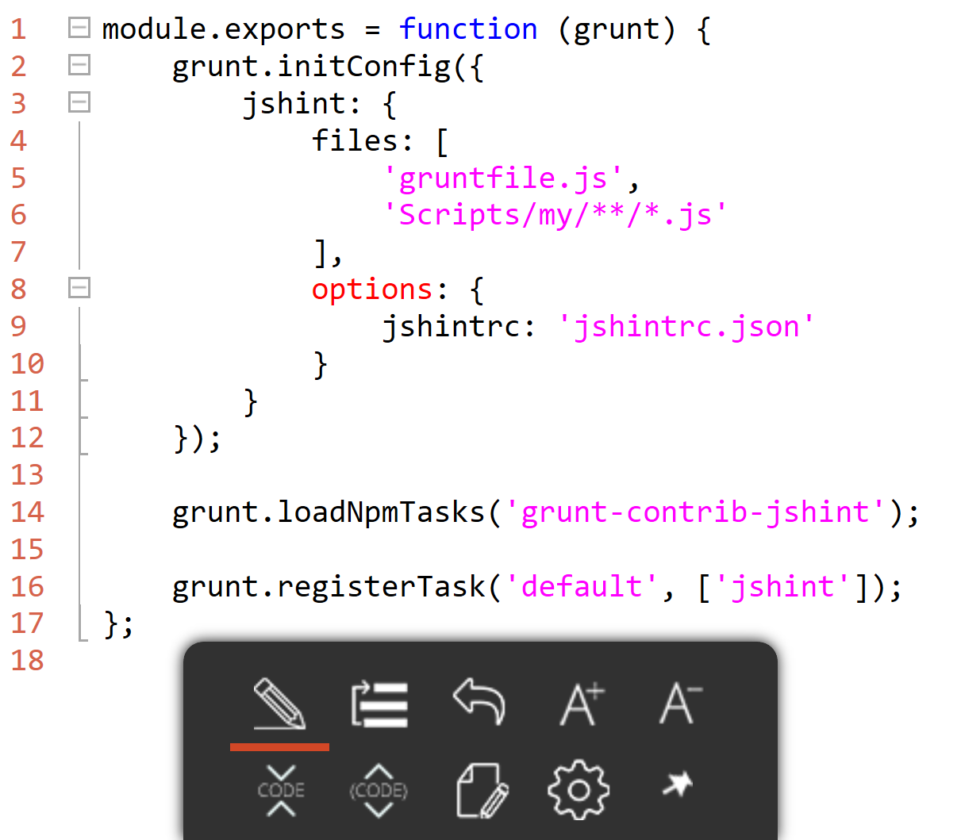
Configuration vs. Code
gruntfile.js
gulpfile.js

Slide 16
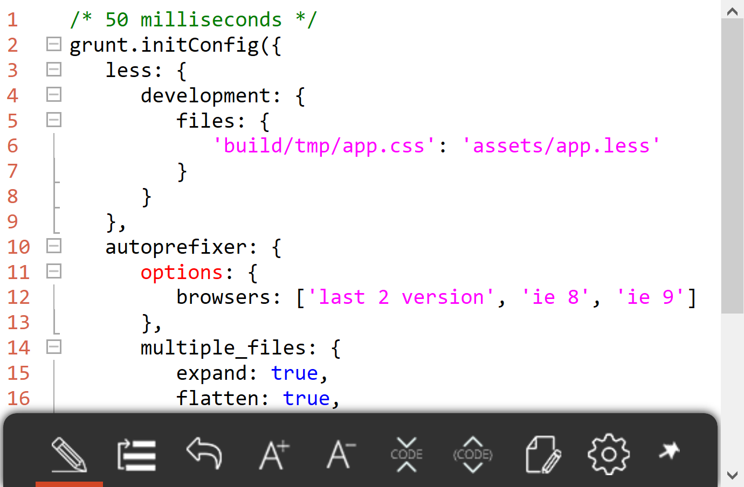
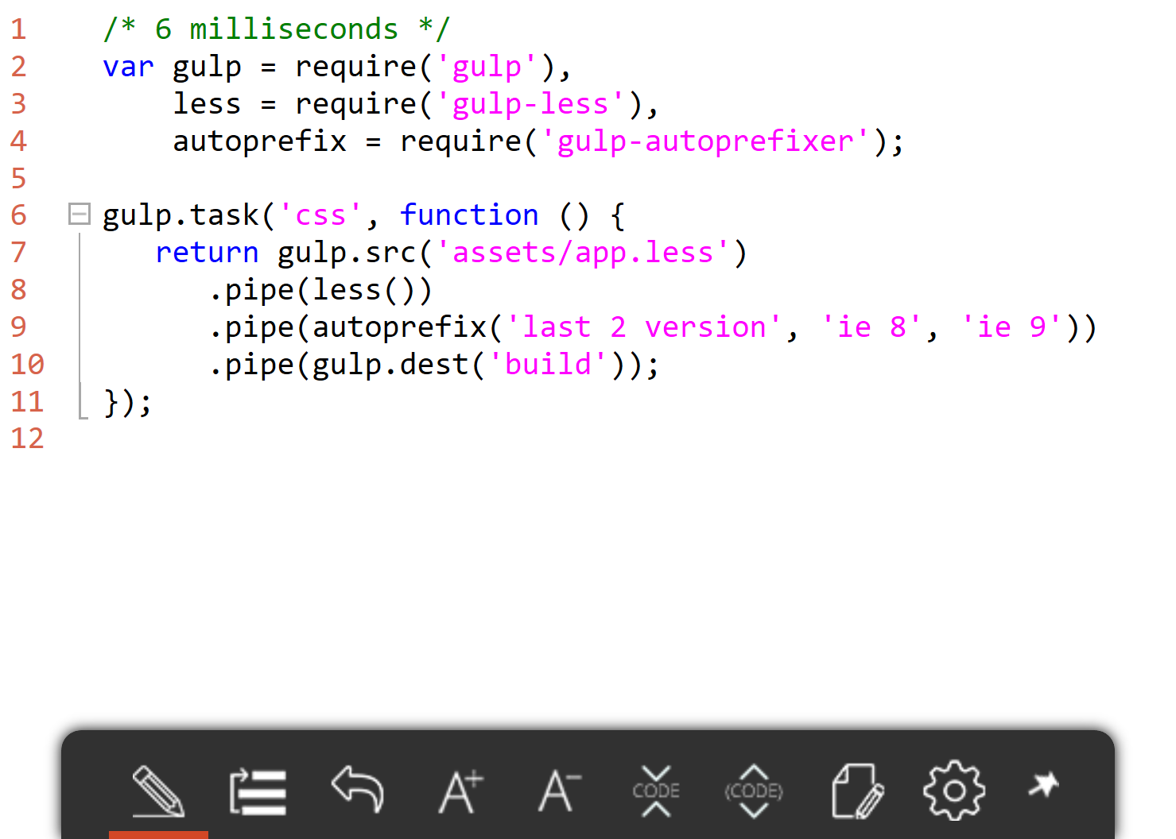
Performance comparison Processing 1 small LESS file
gruntfile.js
gulpfile.js
http://bit.ly/1oUxzhL

Slide 17
Dashboard view
GitHub Contributors | 55 | 146
GitHub Stars | 10,058 | 16,027
Plugins | 5,232 | 1,870
Creator | Bocoup | Fractal
Inception | March 2012 | July 2013
ASP.NET 5 Default |  | X

Slide 18
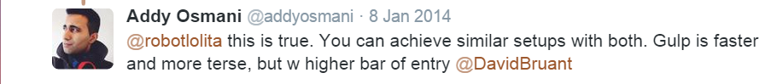

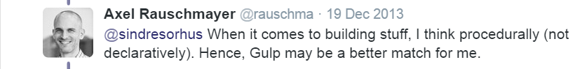
Tweets from thought leaders How do I choose?

Slide 19
What I’ve learned
Observations from the past year

Slide 20
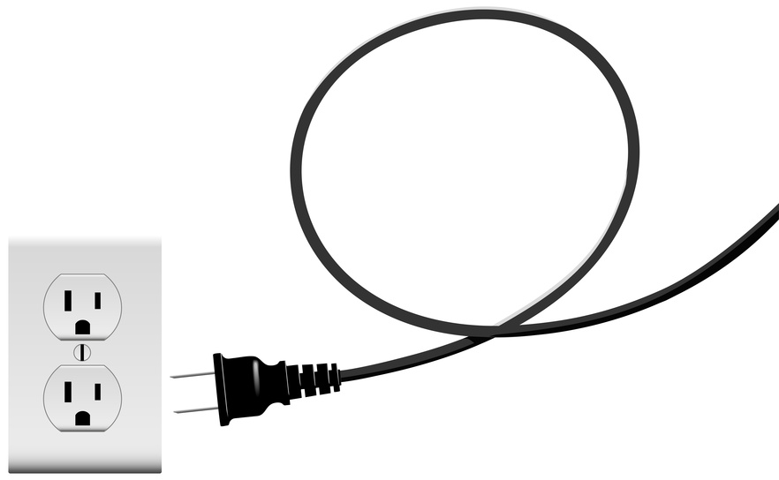
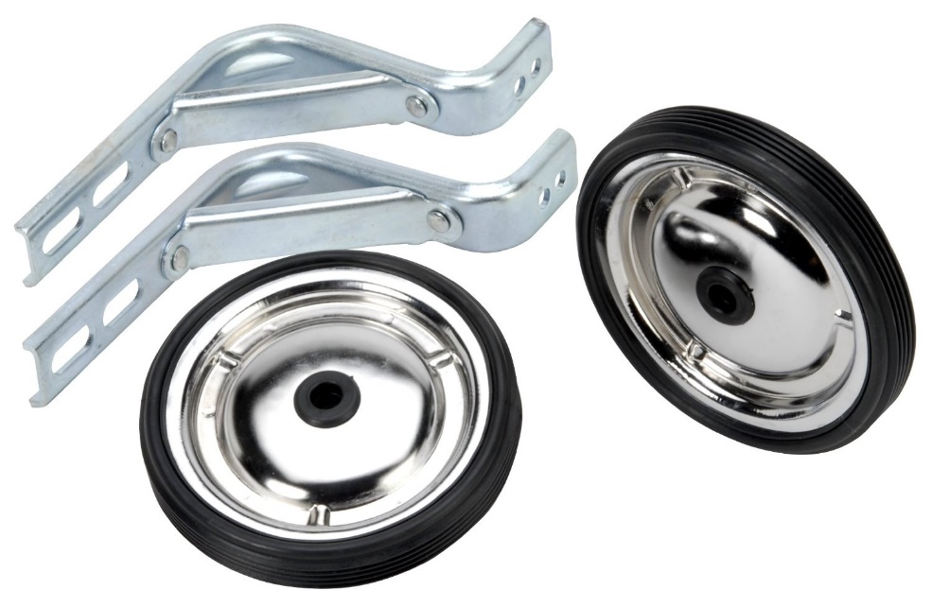
Plugins are Node.js training wheels

Slide 21

Debugging Grunt tasks is frustrating

Slide 22
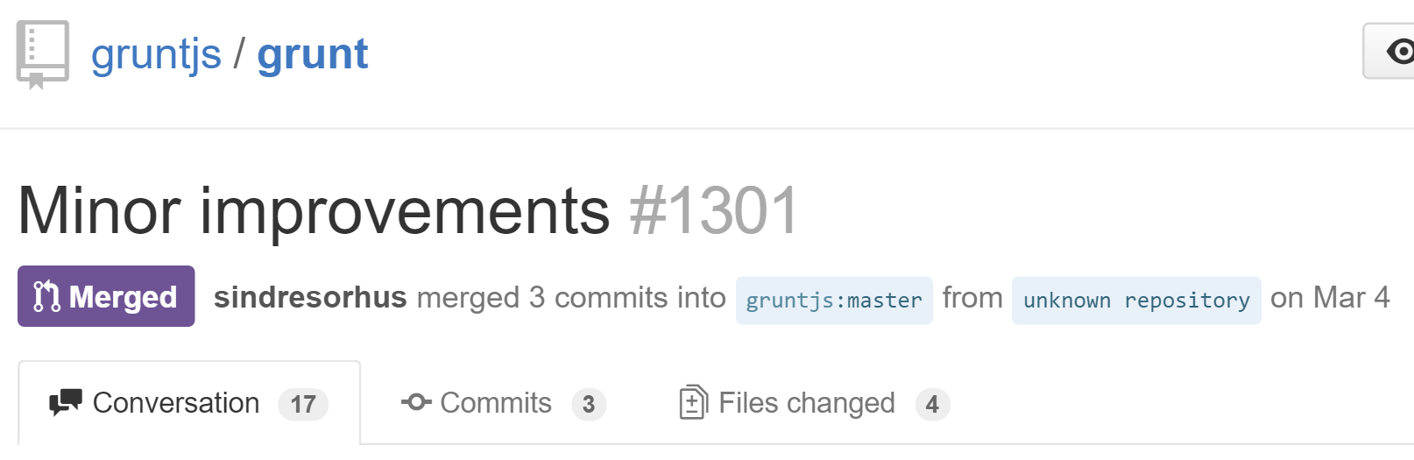
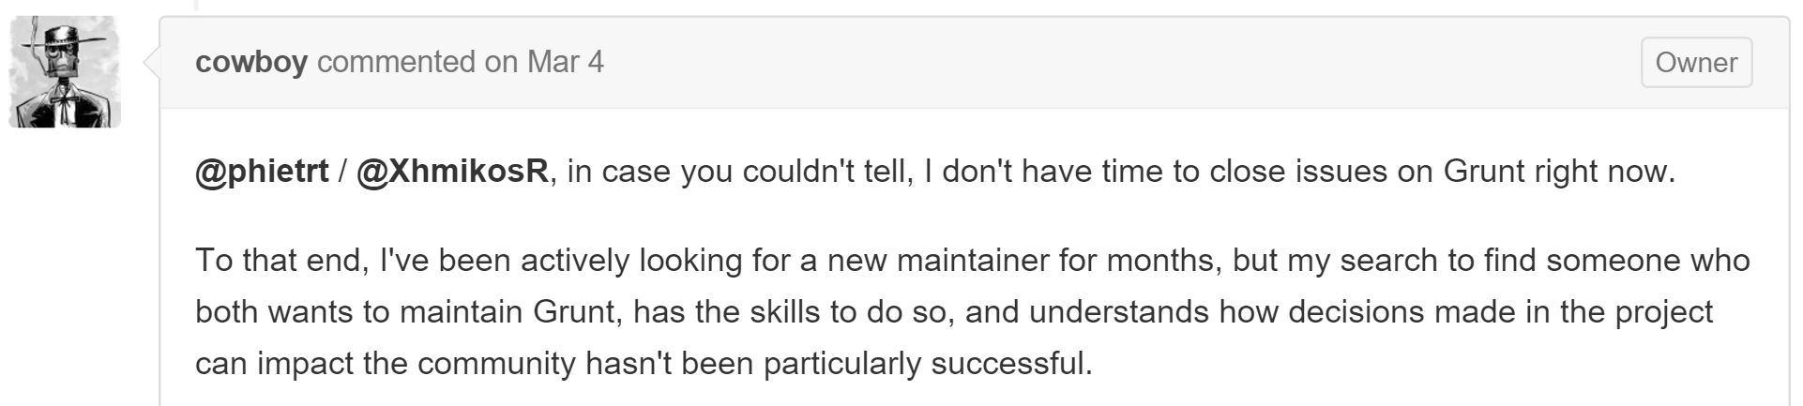
Uncertainty in repo ownership
http://bit.ly/1LI1swc

Slide 23
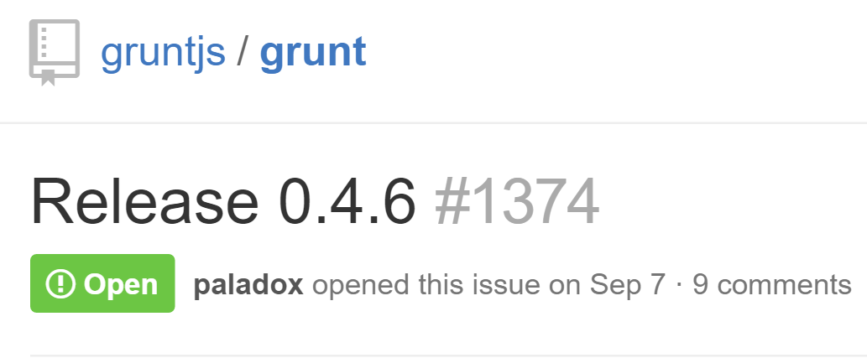
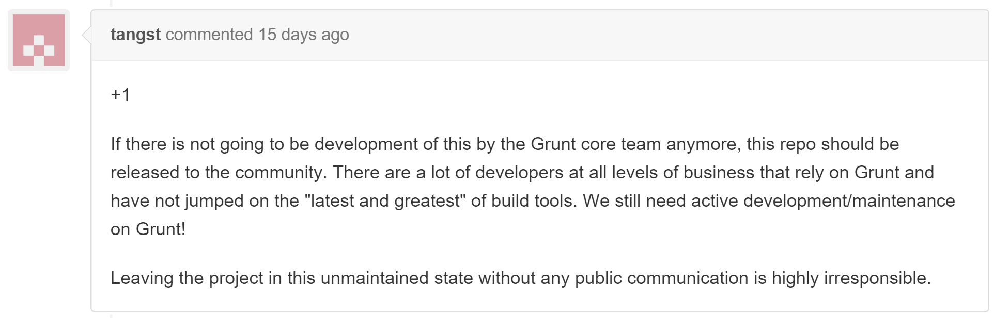
Repo abandonment
http://bit.ly/1LpPhq7

Slide 24
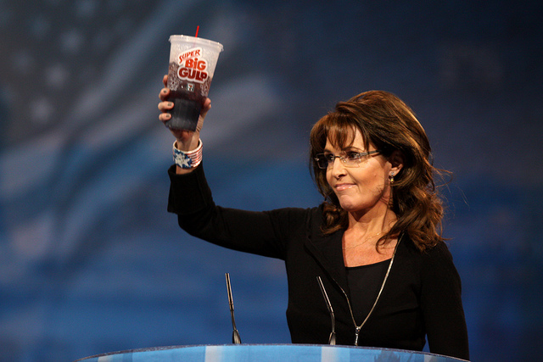
…and the winner is

Slide 25

How to use Gulp in your project
5 Easy Steps

Slide 26
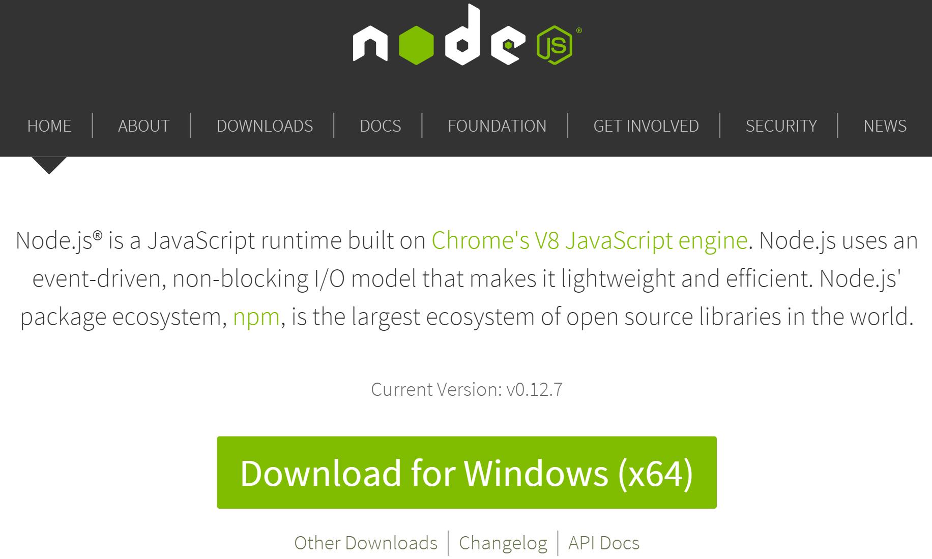

Prerequisites Node.js & NPM (Node Package Manager)
Install via nodejs.org:
…or via chocolatey.org:
PS:\>iex ((new-object net.webclient).DownloadString('https://chocolatey.org/install.ps1'))
PS:\>choco install nodejs.install

Slide 27
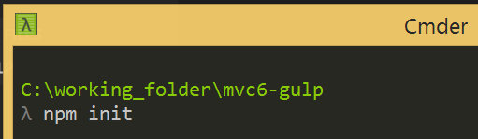
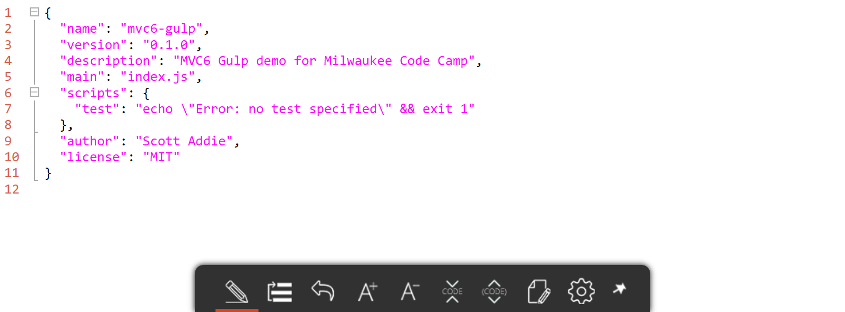
1. Create package.json file

Slide 28
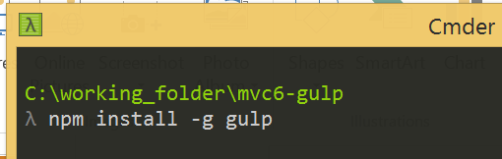
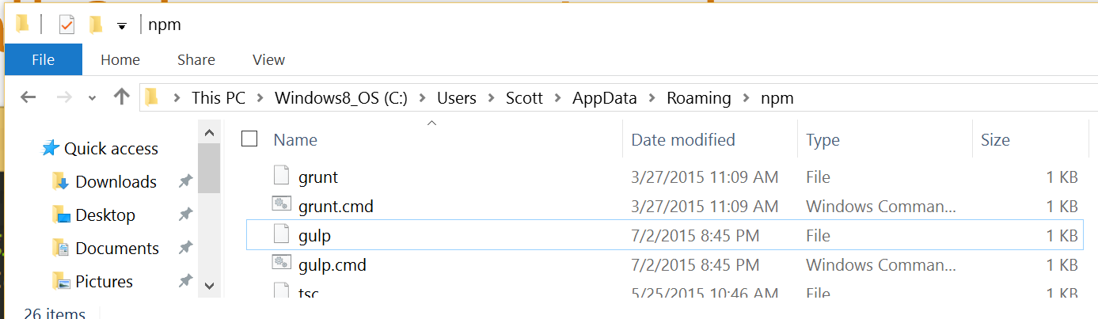
2. Install Gulp at system Level

Slide 29
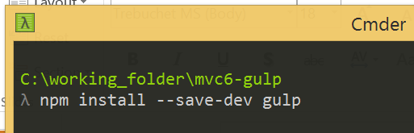
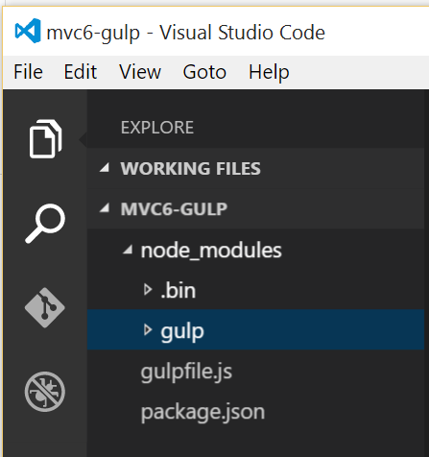
3. Install Gulp locally

Slide 30
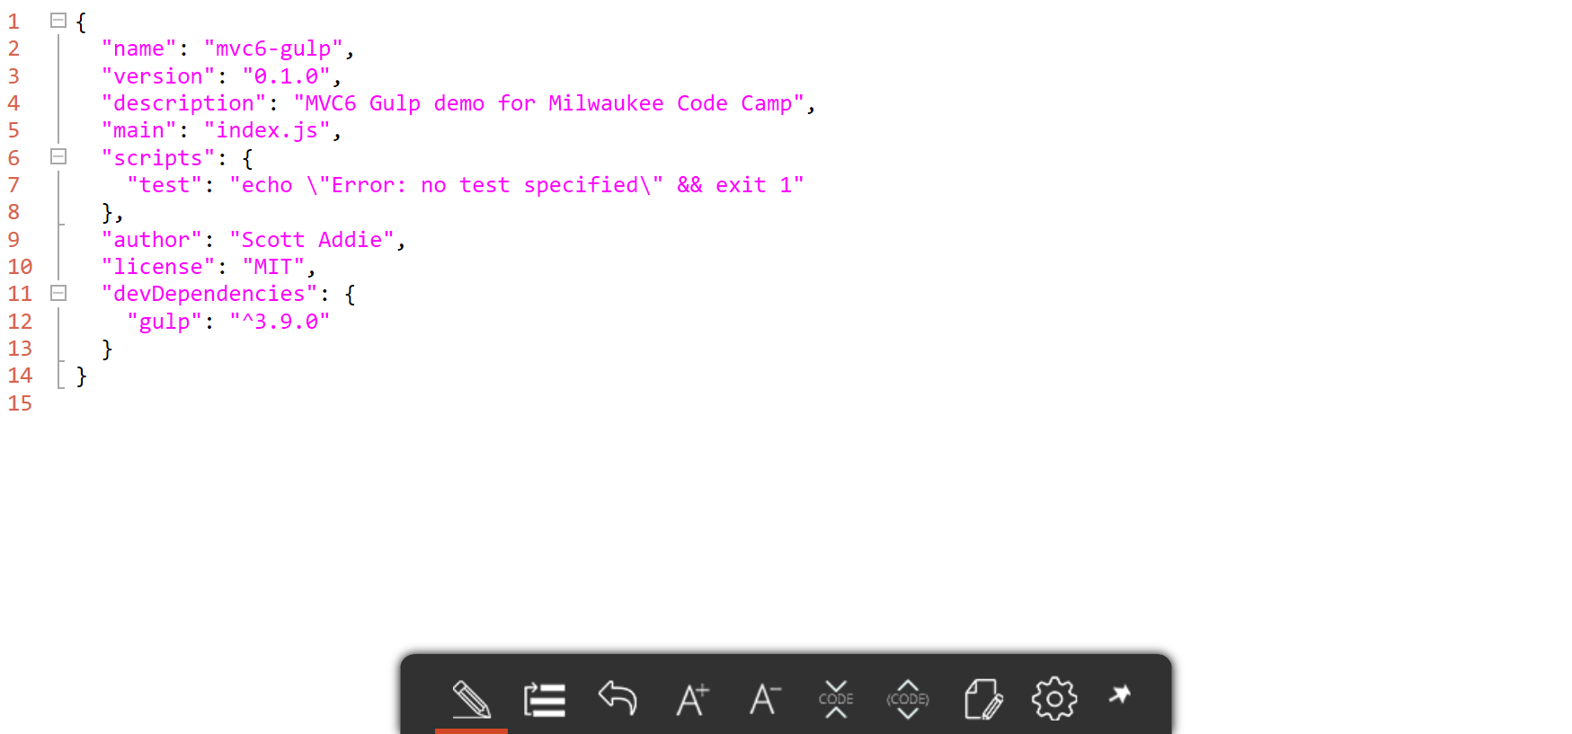
3. Install Gulp locally (cont.)

Slide 31
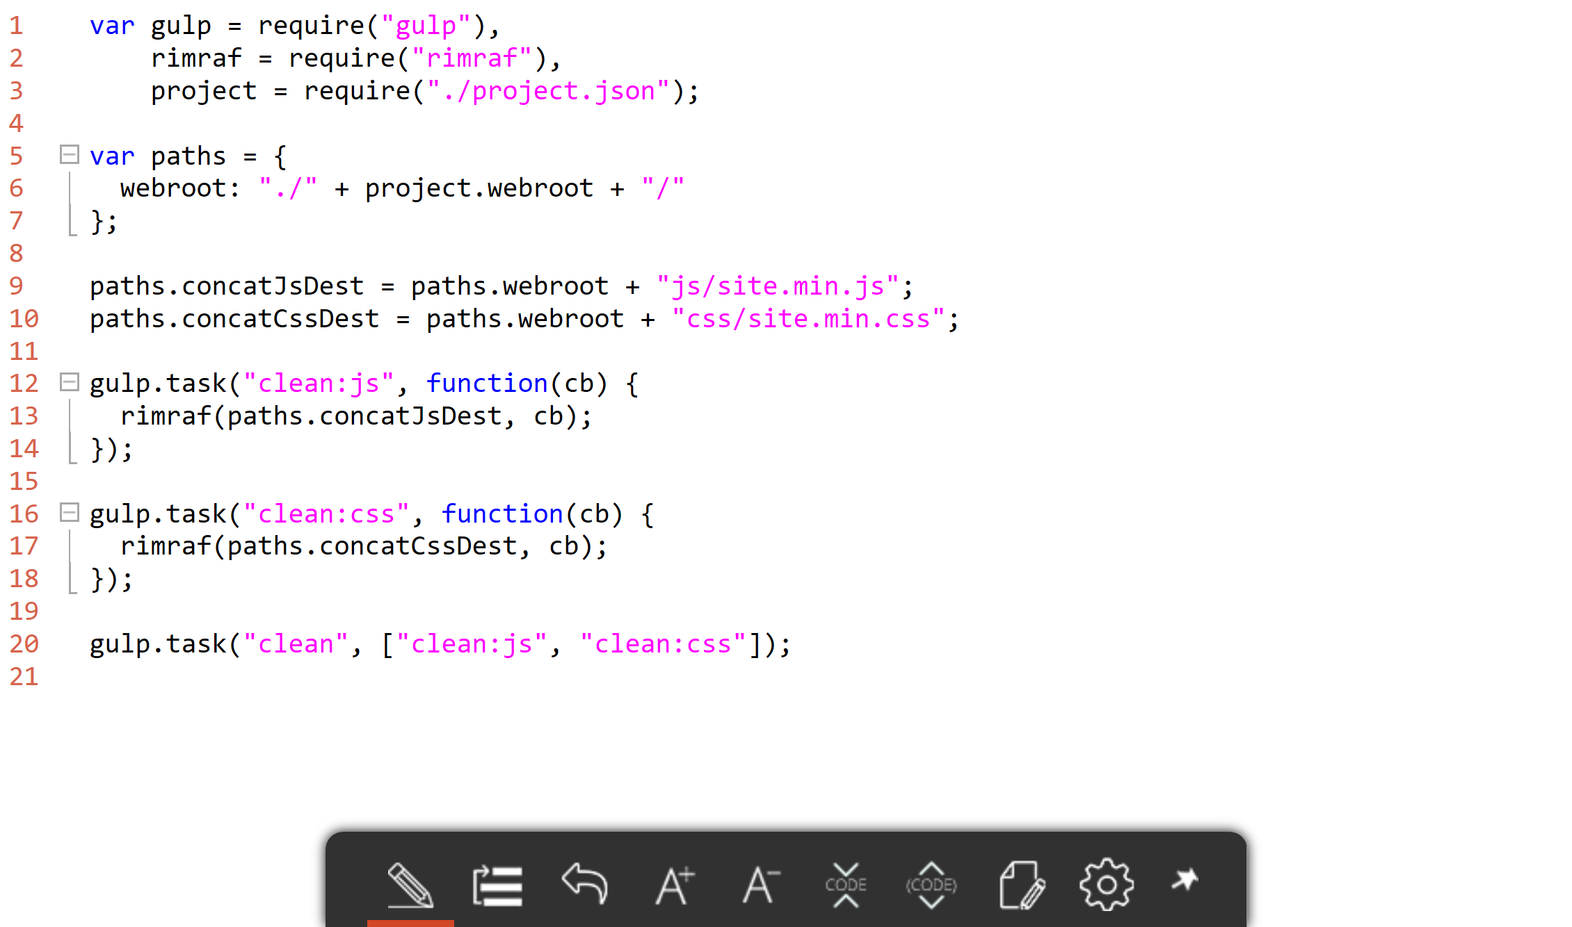
4. Create gulpfile.js

Slide 32
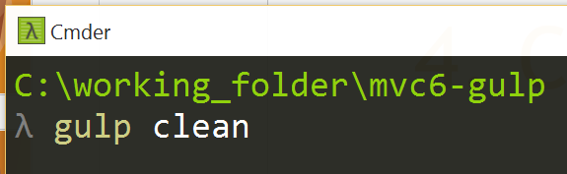
5. Run Gulp task

Slide 33


Demo
let demo = + ( || );
Using Gulp w/ ASP.NET 5 in VS Code or VS 2015

Slide 34
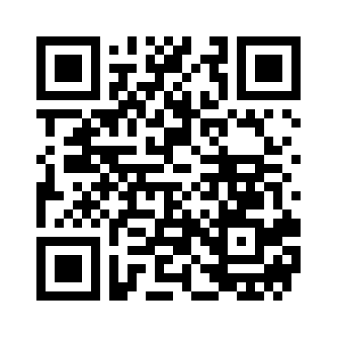
Resources
Scan QR for slides & code:
Official Gulp website
Using Gulp with ASP.NET 5
JavaScript Build Automation with Gulp.js
John Papa, Pluralsight course
Gulp and Grunt at Anglebrackets
John Papa, blog post

